Slide 1
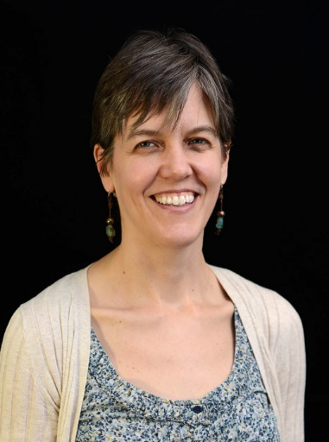
Usability Testing April 2018
Mary Cook
ITS User Experience Project Manager

Slide 2
Working in UX Field
Nielsen Norman Group
Effective UX means interacting with users, not just “thinking about” users.

Slide 3
Outline
User Interface Tips
Usability Testing

Slide 4
Don’t Use… | Do Use..
Icons without labels | Icon, labels, & short description
Hero image | Short wide image so content is visible below
Hamburger menu on desktop | “Menu”, 4 tabs, mega menus
In-field text on a form | On forms, put label on top of field not inside.
“More” links | Links with exact descriptions, even if long
“Desktop-only” design | Design for mobile & desktop

Slide 5
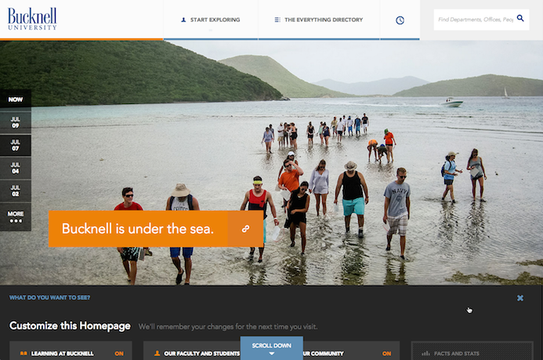
Notes:
https://www.nngroup.com/articles/breaking-web-conventions/

Slide 6
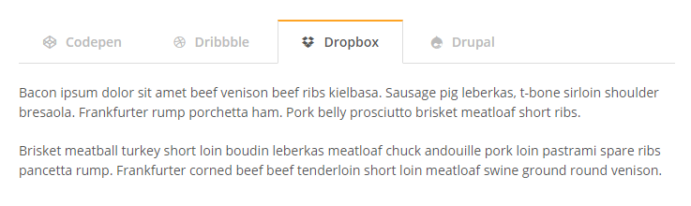
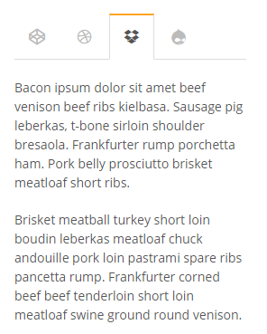
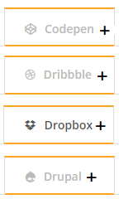

Slide 7
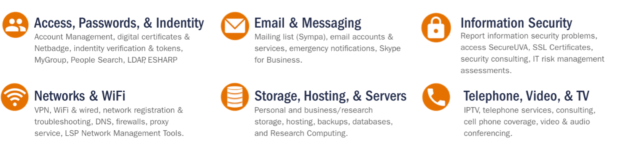

Slide 8
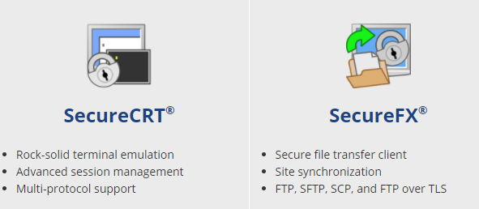

Slide 9
Don’t Use… | Do Use..
Icons without labels | Icon, labels, & short description
Hero image | Short wide image so content is visible below
Hamburger menu on desktop | “Menu”, 4 tabs, mega menus
In-field text on a form | On forms, put label on top of field not inside.
“More” links | Links with exact descriptions, even if long
“Desktop-only” design | Design for mobile & desktop

Slide 10
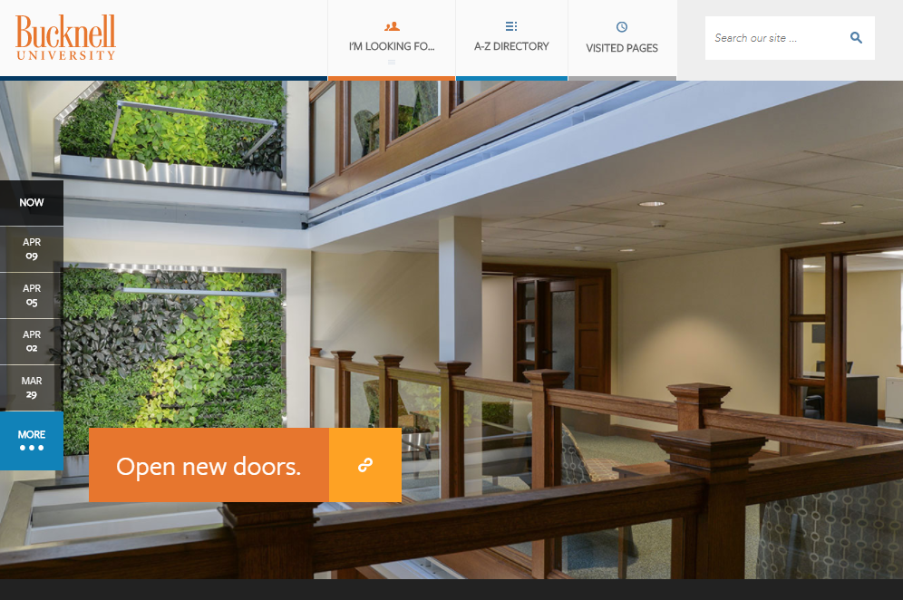
Notes:
https://www.nngroup.com/articles/breaking-web-conventions/

Slide 11
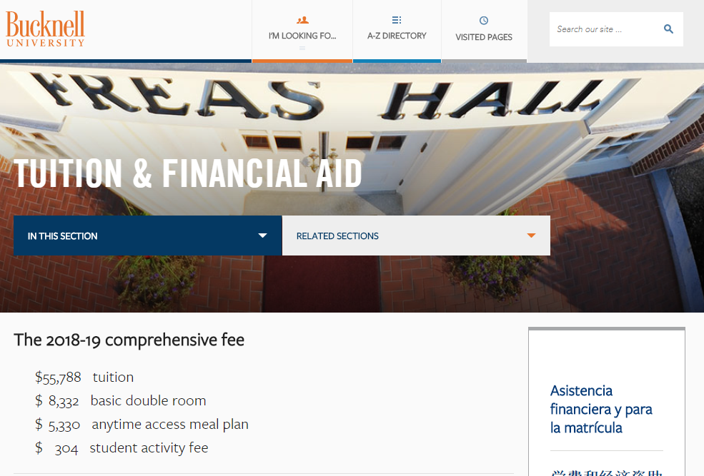
Do

Slide 12
Don’t Use… | Do Use..
Icons without labels | Icon, labels, & short description
Hero image | Short wide image so content is visible below
Hamburger menu on desktop | “Menu”, 4 tabs, mega menus
In-field text on a form | On forms, put label on top of field not inside.
“More” links | Links with exact descriptions, even if long
“Desktop-only” design | Design for mobile & desktop

Slide 13
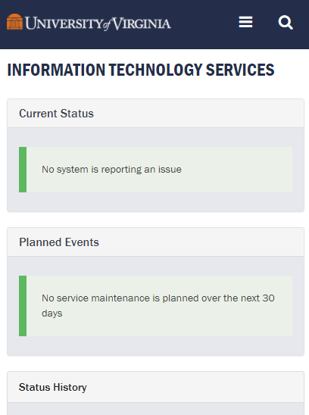
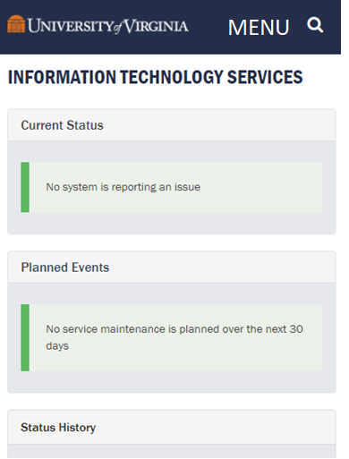
OK Better

Slide 14
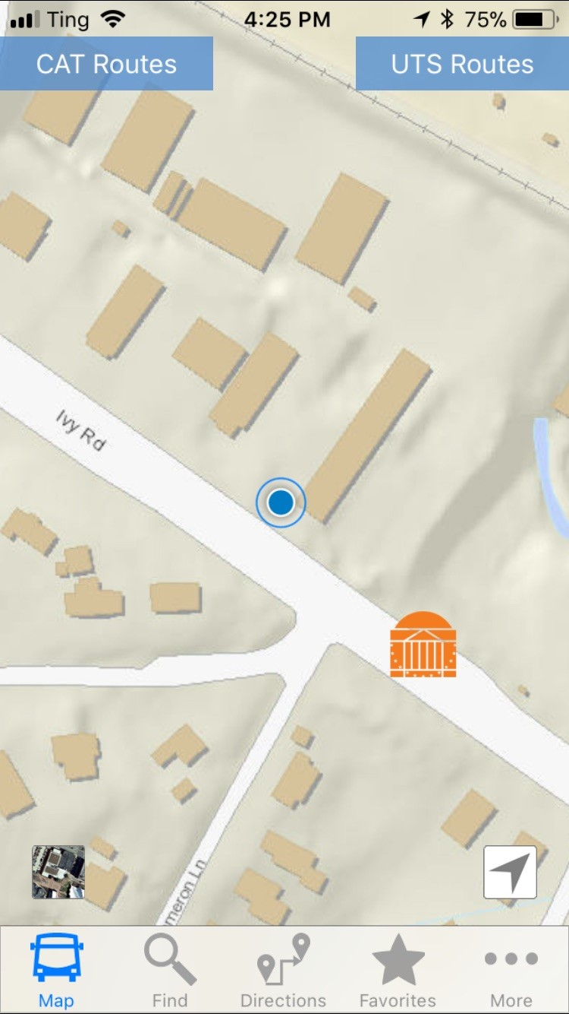

Slide 15
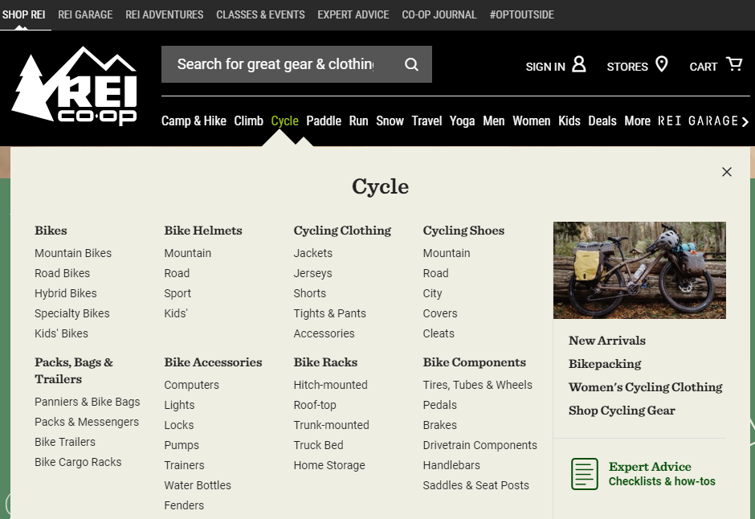

Slide 16
Don’t Use… | Do Use..
Icons without labels | Icon, labels, & short description
Hero image | Short wide image so content is visible below
Hamburger menu on desktop | “Menu”, 4 tabs, mega menus
In-field text on a form | On forms, put label on top of field not inside.
“More” links | Links with exact descriptions, even if long
“Desktop-only” design | Design for mobile & desktop

Slide 17
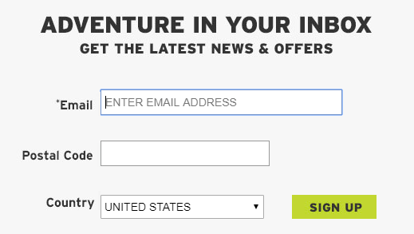
https://www.nngroup.com/articles/web-form-design/

Slide 18
Don’t Use… | Do Use..
Icons without labels | Icon, labels, & short description
Hero image | Short wide image so content is visible below
Hamburger menu on desktop | “Menu”, 4 tabs, mega menus
In-field text on a form | On forms, put label on top of field not inside.
“More” links | Links with exact descriptions, even if long
“Desktop-only” design | Design for mobile & desktop

Slide 20
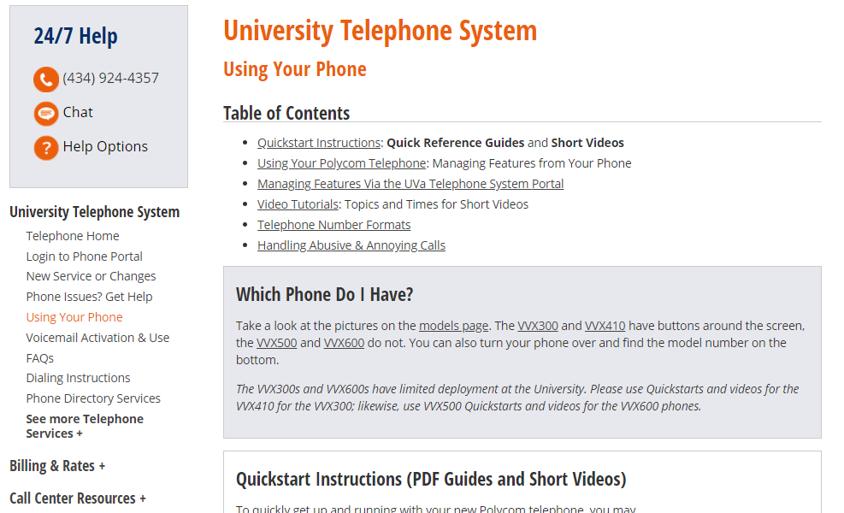

Slide 21
Don’t Use… | Do Use..
Icons without labels | Icon, labels, & short description
Hero image | Short wide image so content is visible below
Hamburger menu on desktop | “Menu”, 4 tabs, mega menus
In-field text on a form | On forms, put label on top of field not inside.
“More” links | Links with exact descriptions, even if long
“Desktop-only” design | Design for mobile & desktop

Slide 22
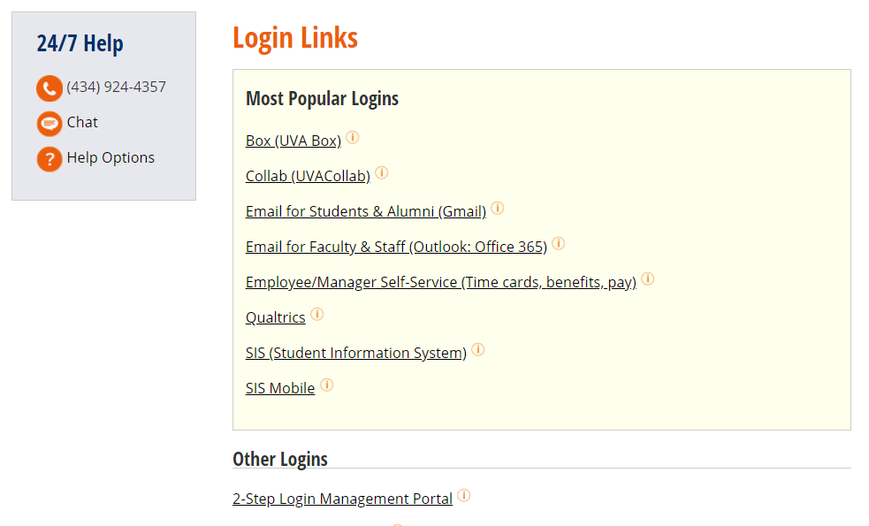

Slide 23
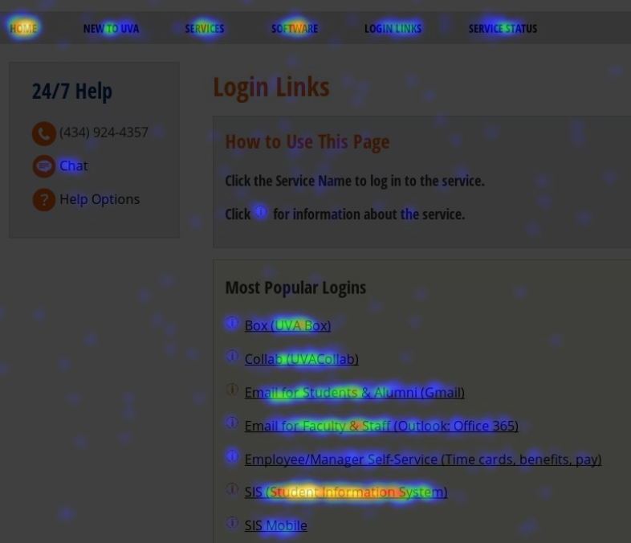

Slide 24
Summary of Findings
“In sight in mind” improve usability.
Call things what they are.
“Discoverability” and “Getting Started” are critical.
To make a user interface simple, the backend is often very complex and vice versa.

Slide 25
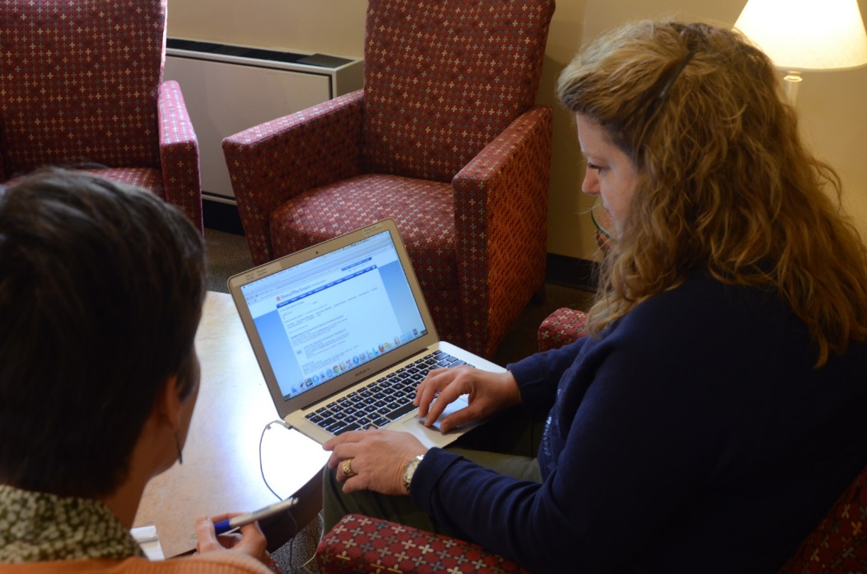
Usability Testing

Slide 26
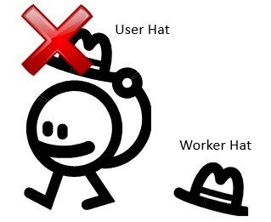

Usability Testing Basics
Test 5 users and learn 85% of the issues*
You are not the user.
*http://www.nngroup.com/articles/why-you-only-need-to-test-with-5-users/

Slide 27
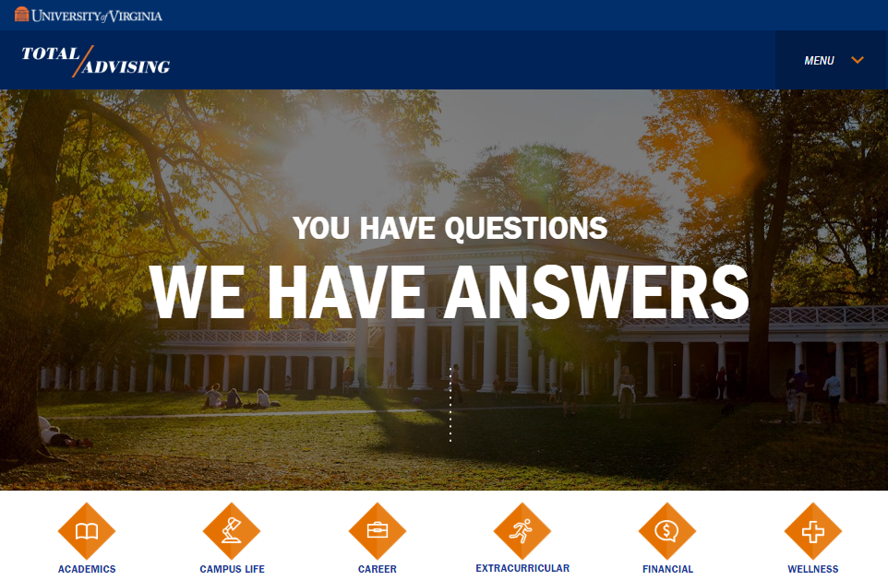

Slide 28
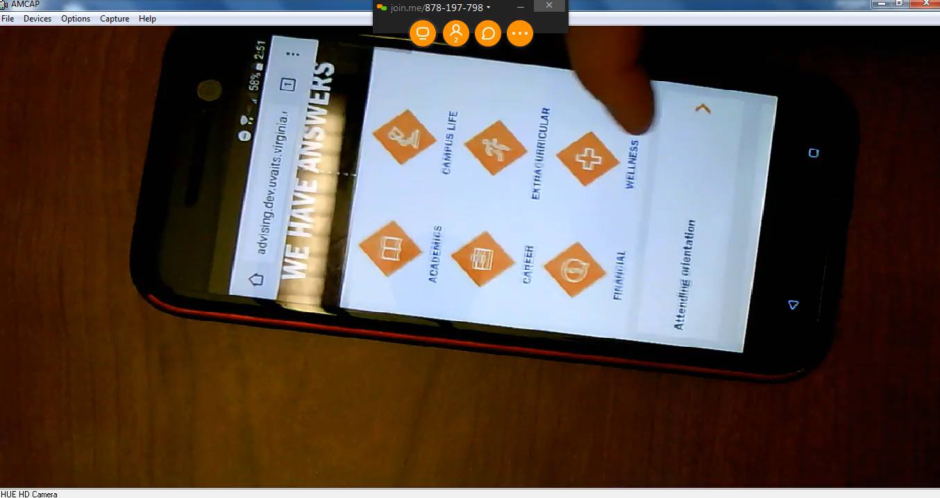

Slide 29
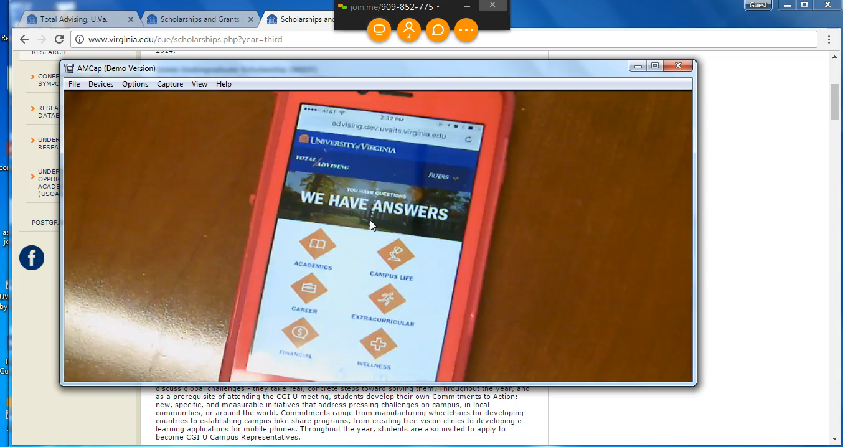

Slide 30
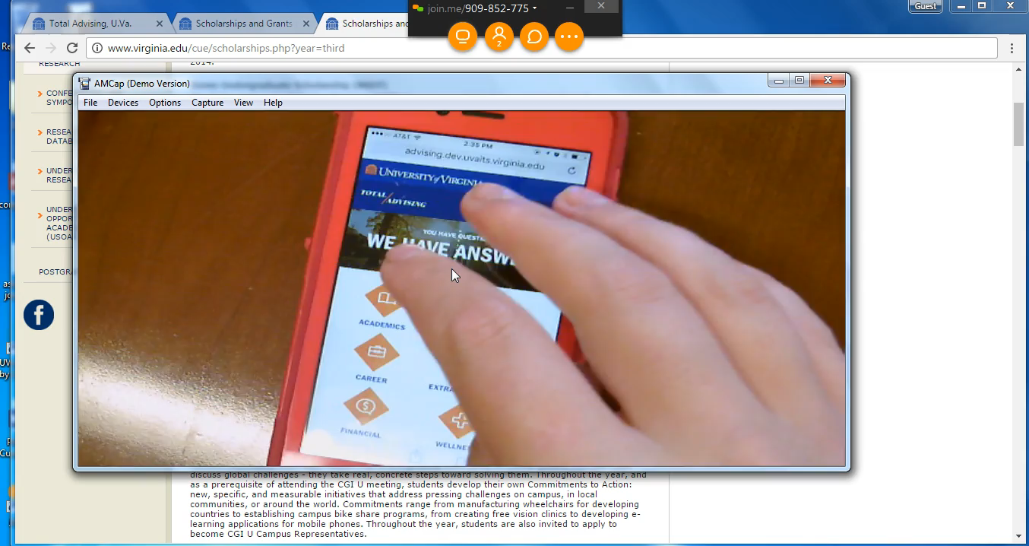

Slide 31
Usability Testing
Unmoderated Testing. Your job will be:
What questions do you want to answer?
Write tasks
In-Person Testing. Same as above, plus…
Recruit people unfamiliar with the project
Run a pilot test
Be quiet – listen!

Slide 32

Writing Tasks
Tips for writing tasks
http://www.nngroup.com/articles/task-scenarios-usability-testing
Estimate 5 -10 tasks for 60 minute test
Print tasks on individual slips of paper
Make the first task easy
Writing tasks activity – Break into groups!

Slide 33
Tips for Facilitating Tests
Don’t facilitate tests of your work if someone else can.
Avoid helping participants – Let them fail.
Avoid answering questions – “Hmm…I’m not sure.” or “How do you think it should work?”
Prompt the user to talk – “Tell me what you are trying to do now.”
Write down everything! - What the person is doing, quotes, where the person clicks
Notes:
Mary
User asks - can I do this? “I’m not sure” Does this mean this?
Don’t lie

Slide 34
Tips for Facilitating Tests (Cont)
Keep a running list of issues.
Don’t solve the problems while you are testing.
Facilitate observers asking questions.
Don’t change the questions during testing (sometimes)
If you miss something, ask the user to show you again.
Notes:
If you can afford to have someone facilitate and another take notes, then by all means do it.
Pilot test is very valuable.

Slide 35
Resources
How to Guerilla Test
http://uweb.virginia.edu/2014/09/guerrilla-usability-testing-at-uva/
What Users Do (unmoderated testing)
https://www.whatusersdo.com
Invision (for interactive prototypes)
http://www.invisionapp.com/

Slide 36



Conclusion
If you intend your web sites and applications to be used by people, then it’s essential that you understand what people want and need from your systems.

Slide 37
Next Steps
Be Brave! Conduct a test as part of your class project.
Sign up to test - $10 per test
in.virginia.edu/its-usability
Raffle
Be a usability advocate at your future jobs.

